Slide 1

PROJECT TITLE:-
ABES Engineering College, Ghaziabad, UP
Department of Information Technology
Mini Project Presentation
ROUTE DELAY NOTIFIER
(USING PYTHON)
Name: Hitesh Agrawal
Roll No. : 1900320130074

Slide 2




Slide 3
Programming for Everybody (Getting Started with Python)
About this Course
This course aims to teach the basics of programming computers using Python.
Topics Covered in Course:
Variables and Expressions
Conditional codes
Functions
Loops and Iterations

Slide 4
HTML, CSS, and Javascript for Web Developers:-
Topics Covered in Course:
Use of basic tools for web page development.
Introduction to HTML.
Introduction to CSS & JAVA SCRIPT.
Basics of how a web page runs.

Slide 5

CONTENT
Introduction
Requirements of Projects
Implementation
Output Screen
Conclusion
Future Plan
Coursera Certificate

Slide 6

REQUIREMENTS OF PROJECTS:
HARDWARE REQUIRED:-
Processor : 32-bit , dual core and above
Ram : 4 gb
Pointing device : mouse and keyboard
softWARE REQUIRED:-
Os : windows (7,8,10)
Spyder
Python 3.9.2

Slide 7

INTRODUCTION:
It is real-life problem solving program.
It is a Python script that queries the Maps Platform (using the Distance Matrix API). When there's too much traffic on your commute to college and you cannot make to college on time, then it will automatically email the recipient that “I am going to be late”!

Slide 8


IMPLEMENTATION :
IF TIME
Exceed the
limit
ENTER YOUR CURRENT LOCATION
RECIPIENT RECEIVES AN EMAIL

Slide 9
FUNCTIONALITY:
MODULE USED
Requests -
The requests module allows you to send HTTP requests using Python. The HTTP request returns a Response Object with all the response data (content, encoding, status, etc).
Smtplib -
Simple Mail Transfer Protocol (SMTP) is a protocol, which handles sending e-mail and routing e-mail between mail servers.
Python provides smtplib module, which defines an SMTP client session object that can be used to send mail to any Internet machine with an SMTP or ESMTP listener daemon.
SYNTAX: requests.methodname(params)
SYNTAX: smtplib.SMTP("smtp.gmail.com", 587)

Slide 10
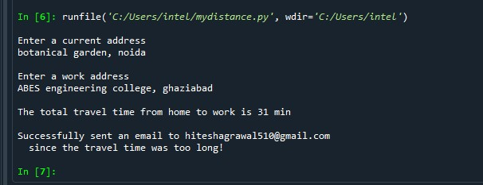
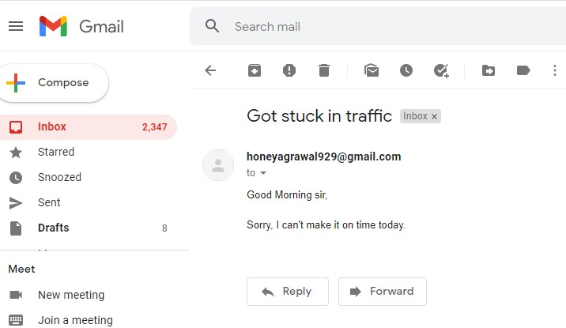
Output screen :
Email successfully send to the recipient
Total travel time

Slide 11
CONCLUSION:
It is an automated python progam which operates on real time basis.
It is an anytime anywhere operation to take place.
Its purpose is to save time of an individual by automatically sending an email without using g-mail applicaton.

Slide 12
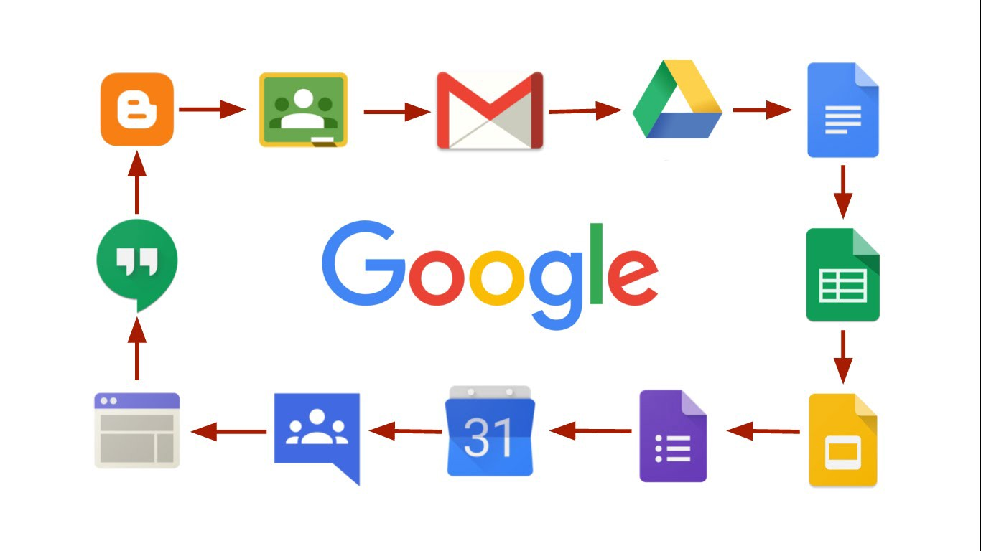
FUTURE PLANS:
We can add more functionalities by linking other operations.
By accumulating all operations in a single APP
will make it more useful.

Slide 13
References:-
Google.com
Youtube
https://distancematrix.ai
https://mail.google.com

Slide 14
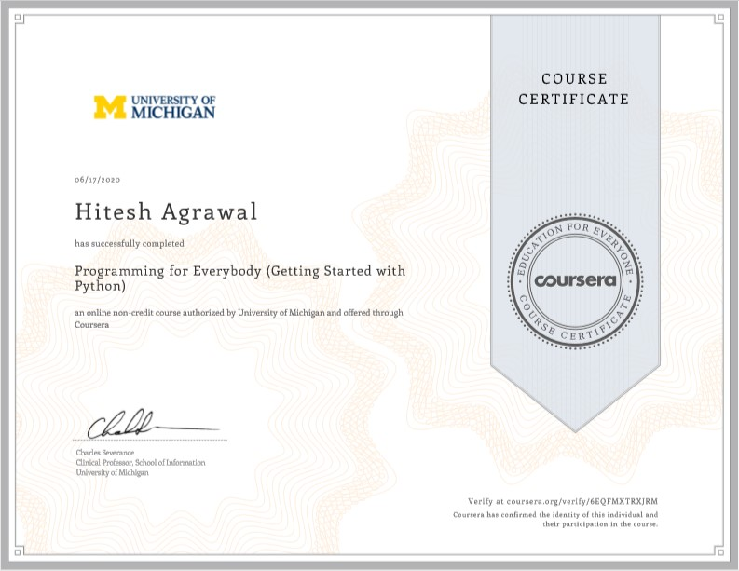
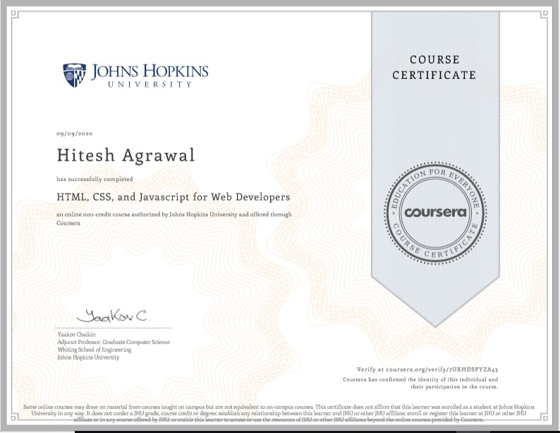
Certificate of Courses:

Slide 15


Slide 16


